Slide 1
Agenda
2
4
Convolutional Neural Network -Image Classification
Conclusion
Vehicle Detection Model Evaluation
5
Descriptive Properties of the Data
CNN Model and Results
1
3

Slide 2


Vehicle Detection Model Evaluation
1
Keras is an open
source neural network library
KITTI Vision Dataset

Slide 3

Descriptive Properties of the Data
2
1531 training data set
1
Vehicle
262
Vehicle
Not Vehicle
0
Not Vehicle
1269

Slide 4
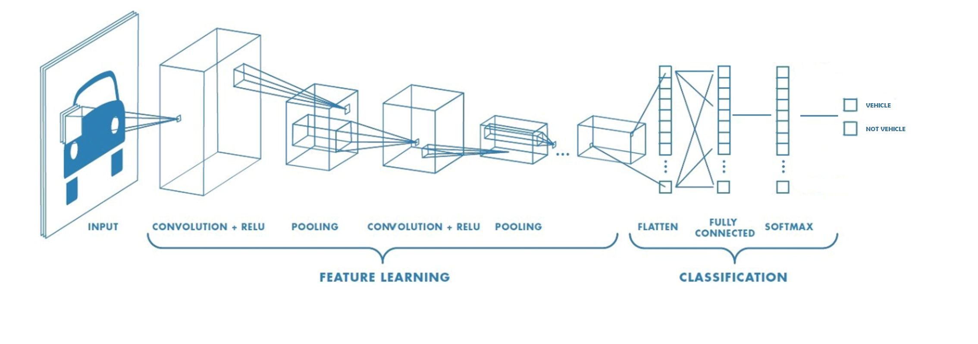

Convolutional Neural Network - Image Classification
3

Slide 5
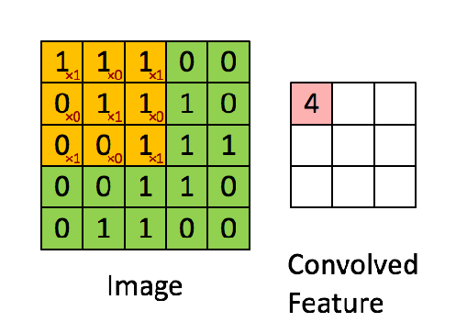
Convolutional Layer
Example Image
1
1
1
0
0
0
1
1
1
0
0
0
1
1
1
0
0
1
1
0
0
1
1
0
0
Filter
1
0
1
0
1
0
1
0
1

Slide 6

Relu Layer
Applying an activation function onto feature maps to increase non-linearity in the network.

Slide 7

Pooling Layer
Decrease the computational power required to process the data.

Slide 8
Flatten Layer
Flatten the pooled feature map into a sequential column of numbers, a long vector.

Slide 9

Fully Connected Layer
Fully Connected layer is to use high-level features from the input image in order to classify classes based on train data.

Slide 10
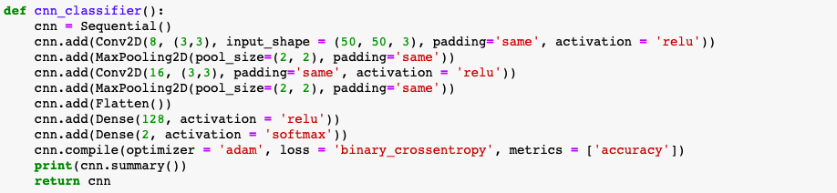
CNN Model and Results
4
Building Model

Slide 11
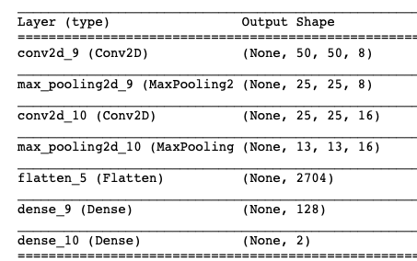
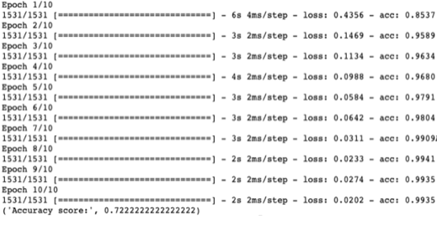
CNN Model and Results
4
Convolutional Neural Network Layer’s Output
Test Samples Result

Slide 12
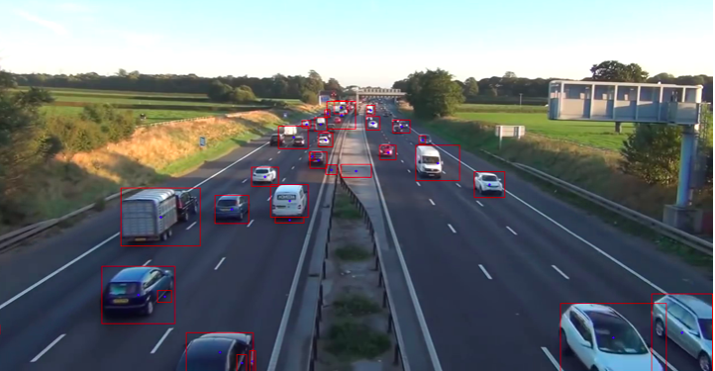
18
15
16
9
14
13
10
17
12
8
2
1
11
5
6
7
6
4
3
3
2
1
4
5

Slide 13
CNN Model and Results
4
75%
Vehicle
18
6
25%
Not Vehicle

Slide 14
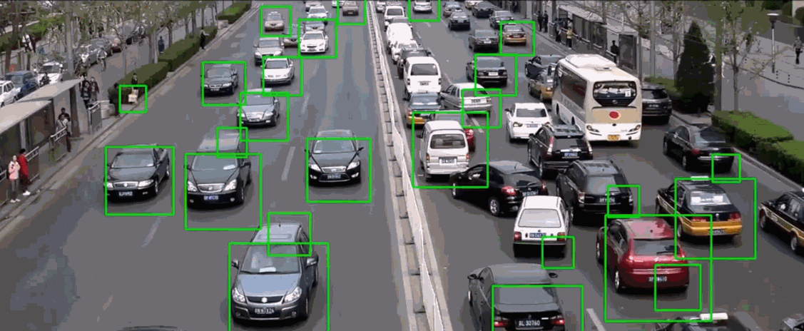
Conclusion
5
The proposed system detected vehicle, calculating density and evaluate accuracy with an artifical intelligence approach.

Slide 15

Conclusion
5
Compared to other techniques, using image processing the system can deliver a great impact and it is capable of producing an efficient result in real-time.

Slide 16

Conclusion
5
The scheduling of the traffic light is conducted regardless of detection of the instantaneous traffic density. Because of this, time is wasted.
Our proposed system results can be used traffic light programming to make them more efficient.

Slide 17
References
4
Dakshayani Ijeri ,Amar.Gulaganji,Abhishek.A.Mandewali “A Survey on Intelligent Traffic Control System Using Image Processing ”, 2019 International Conference on Signal Processing and Communication, 2019
Meisam Razavi ,Mehdi Hamidkhani,Rasool Sadeghi “Smart Traffic Light Scheduling in Smart City Using Image and Video Processing ”, Third International Conference on Internet of Things and Applications, 2019
Kurniawan, J., Syahra, S. G., & Dewa, C. K. “Traffic Congestion Detection: Learning from CCTV Monitoring Images using Convolutional Neural Network” 2018, Procedia computer

Slide 18
Thank you for listening

